Slide 1
Test Kitchen and Inspec for Your Infrastructure
Aaron Blythe

Slide 2

sponsors
platinum
gold
silver
Notes:
I want to thank all of the wonderful sponsors that put on this great conference. Without them we would not be here.

Slide 3

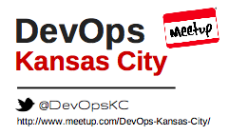
Aaron Blythe
@ablythe
Notes:
My name is Aaron Blythe. I have worked in Software for over 15 years. I have contributed code to a number of open source projects including Chef, community cookbooks, hubot plugins, and many others. I have had the title of software engineer where I would write code all day, architect where i would write code when I wasn’t in meetings or writing boxes and arrows with markers, and now I am an Automation and System Engineer. And most importantly I am a level 25 Pokemon Trainer. I also have organized the DevOps KC Meetup for the last 4 half years and we are working on organizing our second DevOpsDays in KC.

Slide 4

http://devopsdayskc.org/
CFP is open!!
http://cfp.devopsdayskc.org/
Notes:
I made the drive across state last night to be here. We would love if you here in St. Louis submitted proposals or drove over to attend in September.

Slide 5
https://github.com/aaronblythe/hello_webpage_chef
Notes:
I have attempted to create an experience where if you would like to follow along with the slides or recreate anything that I am about to show you, you can easily do so by cloning this test project. All commands from this presentation should be copy and pastable. I tweeted this link. My twitter handle should be available at the bottom of each slide so you can easily get to it. Personally I leave awesome conferences such as this one with the thought, I should spend time learning that thing that person showed me… but then when is there time to start from scratch?

Slide 6


http://kitchen.ci/
http://inspec.io/
Notes:
Today I’m going to show you how to actually do some things with a few of my favorite tools Test-Kitchen and Inspec.
Test-Kitchen was reimagined 2013 by Fletcher Nichol who now works at Chef.
I’m going to attempt to do live demos… because hey it will be entertaining for you if I fail.

Slide 7

Test Kitchen Steps
Define
.kitchen.yml
Create
Machine
Provision
Machine
Verify
Machine
Destroy
Machine
10 seconds to
10 minutes
10 seconds to
20 minutes
1 second to
2 minutes
1 second to
1 minute
10 mins
4 hours
22 seconds
34 minutes
Notes:
We need to start with what Test Kitchen is. Put simply, it is a harness that allows you to create machines quickly, test the configuration that you have then throw them away. And by quickly I am talking about several minutes to less than a minute. Let me repeat that the software we are looking at today will allow you to test the entire setup of a machine from scratch to your full stack in seconds or minutes.

Slide 8

Enterprise circa 2013 vs. test-kitchen
 | Enterprise VMWare | On Prem Test Cloud | Test Kitchen
Time to create/acquire VM’s | 1 week to 3 months | 10 minutes to 2 days | 1 minute to 30 minutes
Time to recreate VM’s | 1 week to 3 months Reclaim: 2-4 times/year | 15 minutes to 4 hours | 1 minute to 5 minutes
Method to create | Log an Issue - Manual work by separate team | Manual or internally built brittle tooling | Command Line
VM OS Settings | Log an Issue: to create modifications | Log an Issue: to create modifications | Research and test on next run
Notes:
Let me put that into perspective compared to where I was at as a developer only a few years ago. If I was looking to acquire a VM in 2013 (which was the year I was introduced to test-kitchen) in a Enterprise environment I was looking at roughly a 3 month wait. We did have a self-service On-Prem VMWare Cloud however it was brittle, changes to images were not really allowed. Sure you could log an issue, but likely it would not be prioritized. Basically there was a bottle neck so bad that we configuration of machines was almost always manual. We used Chef, but it was for long running virtual machines that were initially configured by hand. A machine you received 3 months ago may not match a machine that you received today. Test-kitchen was a game changer.

Slide 9




















Driver
Provisioner
Platform
Verifier
ec2
Pester
BATS
Notes:
As you are going to see, test-kitchen is quite versatile.
There are drivers for all types of machines/containers from Vagrant and Docker to All your favorite cloud providers. List…
There are provisioners for all of your favorite Configuration Management Tools. List…
It is going to work with Windows, or common Linux Distros.
It will allow you to test the resultant machines with Inspec, ServerSpec, Pester PowerShell, BATS and others.

Slide 10

https://downloads.chef.io/chefdk
Notes:
The easiest way to get Test-Kitchen is to install the ChefDK.
Even if you don’t use Chef.
This package has everything set up for installing Ruby and configuring everything so you can just go.

Slide 11


Install ChefDK on Mac
# install chef tools
brew cask install chefdk
brew cask install virtualbox
brew cask install vagrant
brew cask install vagrant-manager
# upgrade
brew cask reinstall chefdk
brew cask reinstall virtualbox
brew cask reinstall vagrant
brew cask reinstall vagrant-manager
Notes:
If you are on a Mac then you highly recommend you use Homebrew to install or upgrade the tools you need.
Since these applications, you would use the ‘cask’ install type. I have found these casks to be well maintained and have not ran into any issues. We will go over Virtualbox and Vagrant here in a minute.

Slide 12

Install ChefDK on Windows
#install chef tools
choco install chefdk
choco install virtualbox
choco install vagrant
choco install vagrant-manager
# upgrade
choco upgrade chefdk
choco upgrade virtualbox
choco upgrade vagrant
choco upgrade vagrant-manager
Notes:
For the Windows people I would also recommend a package manager to give you that command line install and upgrade process that is common on Linux distributions.
Chocololatey is an awesome tool to do this. It is maintained by Rob Reynolds from Puppet and has solid package management for each of these tools.

Slide 13

Vagrant/Virtualbox
Notes:
I start with Vagrant because it is the simplest.
With Vagrant we will be spinning up an Oracle VirtualBox with many different OS’s

Slide 14
Notes:
I am also going to start with Windows since it takes the longest to spin up and I already have it up and running.

Slide 15


.kitchen.windows.yml
---
driver:
name: vagrant
network:
- ["private_network", {ip: "192.168.34.36"}]
provisioner:
name: chef_zero
verifier:
name: inspec
platforms:
- name: mwrock/Windows2012R2
os_type: windows
transport:
name: winrm
elevated: true
suites:
- name: default
run_list:
- recipe[hello_webpage_chef::default]
attributes:
Notes:
I made some subtle changes to the .kitchen.yml file and now I can bring up a Windows box.
I defined a new file called .kitchen.windows.yml.
I moved the networking up to the general area.
Removed the linux boxes and added a windows box. I have to elevate the privileges and define the transport as winrm.

Slide 16

Kitchen with Windows
(Vagrant/Virtualbox)
export KITCHEN_YAML=.kitchen.windows.yml
chef exec kitchen converge
Notes:
So now I am going to switch over the .kitchen file that is loaded up and re-run kitchen converge.

Slide 17



Where to Get Windows Images
From Microsoft:
https://developer.microsoft.com/en-us/microsoft-edge/tools/vms/
Matt Wrock images on Hashicorp Atlas
https://atlas.hashicorp.com/mwrock
Create your own using Joe Fitzgerald’s Packer Templates
https://github.com/joefitzgerald/packer-windows
Notes:
While that is building, let’s talk about Windows images. Because they are slightly different than Linux images due to licensing. You want to ensure that you are using legally licensed images. There are development licenses that are available for use for 90 days. Microsoft provides many different images with different OS/Browser setups for use for your testing. I prefer the images that are created by Matt Wrock who now works at Chef because dude is very versed in Windows and creates good images that are the right mix of being small but having the right setup for PowerShell and other things. You can also create your own images using Joe Fitzgerald’s Packer Templates. I took a networking class at my local community college recently and had software for that class that would only run on Windows. I used these templates to create an environment to install those tools.

Slide 18

Setup Run
Vagrant instance <default-mwrock-Windows2012R2> created.
Finished creating <default-mwrock-Windows2012R2> (2m11.40s).
…
Chef Client finished, 3/3 resources updated in 03 minutes 36 seconds
Finished converging <default-mwrock-Windows2012R2> (4m28.81s).
Notes:
I want you to know that I cheated and I ran this box before I got up here. Initially this took over 6 and a half minutes to setup. That would seem like an eternity if it was just me filling time for you…

Slide 19

Kitchen Login
open http://192.168.34.36
chef exec kitchen login
Notes:
Let’s take a look at the webpage that is running here.
We see the simple IIS server is running.
So you are logged in to through Windows RDP so you will likely need that installed. I believe it is available from the App Store. The password is simply vagrant all lower case.

Slide 20



Slide 21

.kitchen.yml
---
driver:
name: vagrant
provisioner:
name: chef_zero
verifier:
name: inspec
platforms:
- name: ubuntu-16.04
- name: centos-7.3
suites:
- name: default
run_list:
- recipe[hello_webpage_chef::default]
attributes:
Notes:
I believe this is the file that you get if you create a new cookbook using Chef’s scaffolding.
Driver is vagrant
Provisioner is Chef_zero (or chef_solo I believe they are the same thing now) basically an in-memory Chef that does not call back to the Chef Server.
Verifier is inspec which we will get to later
We are going to create both an ubuntu and a centos box.
Then run our simple chef recipe to set up a basic web server with a single web page.

Slide 22

chef exec kitchen list
chef exec kitchen converge
…
Chef Client finished, 52/115 resources updated in 21 seconds
Finished converging <default-ubuntu-1604> (0m39.31s).
…
Finished converging <default-centos-73> (0m22.75s).
-----> Kitchen is finished. (2m38.52s)
Notes:
The first time you run kitchen converge the image will be downloaded. Depending on your connection this may take a while because these images can be around a Gigabyte in size.
For windows these may be multiple gigabytes. So this is going to take some time for me on Google Fiber at home maybe a couple minutes.

Slide 23
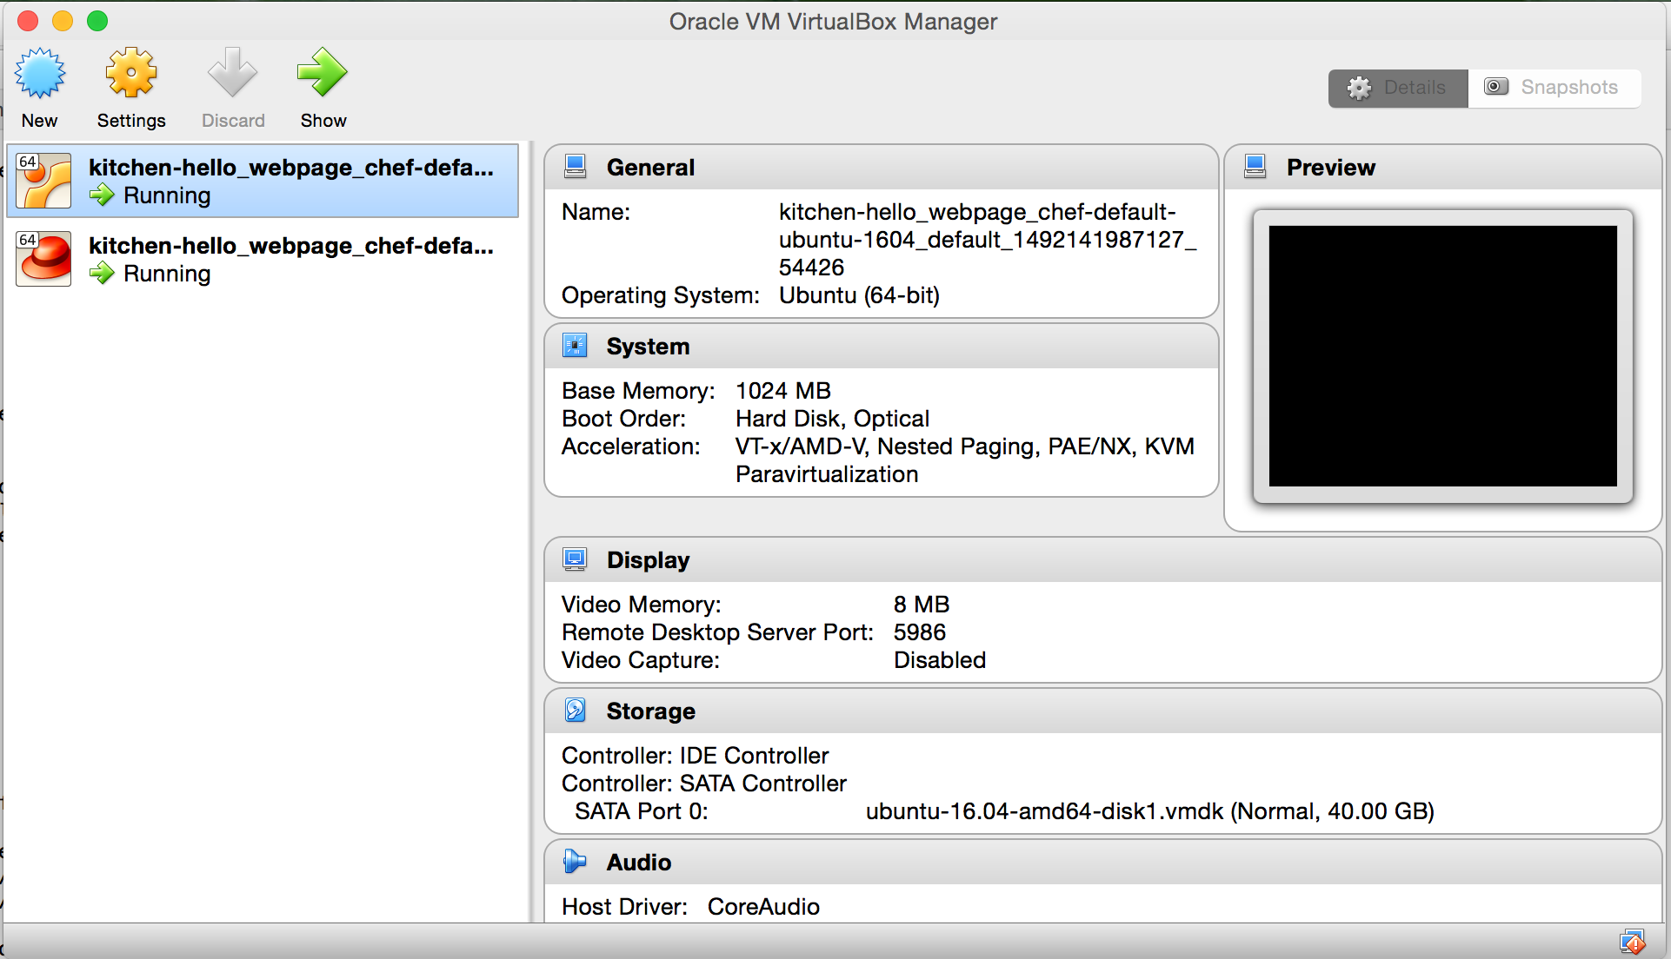
Virtual Box
Notes:
Here you see that there are two VirtualBoxes running from that run without me having to point and click. When I started using Vagrant many years ago I loved it because it made Virtual Box something I could more easily interact with. At that time I did not know all the settings but putting them in a Vagrantfile and running a quick command made this really simple. Test-kitchen has made this even simpler for me. Over time I have learned quite a bit more about the internals of machines and networking, but test-kitchen and vagrant really gave me a platform to get value quicker.

Slide 24

Kitchen Login
chef exec kitchen list
chef exec kitchen login default-ubuntu-1604
Notes:
This command is going to allow me to ssh on to the machine to manually inspect what is going on.

Slide 25


.kitchen.yml
---
driver:
name: vagrant
provisioner:
name: chef_zero
verifier:
name: inspec
platforms:
- name: ubuntu-16.04
driver_config:
network:
- ["private_network", {ip: "192.168.34.34"}]
- name: centos-7.3
driver_config:
network:
- ["private_network", {ip: “192.168.34.35"}]
suites:
- name: default
run_list:
- recipe[hello_webpage_chef::default]
attributes:
Notes:
Now I want to manually ensure that my machines are presenting something I can get to in the browser, so I am going to have to define a private network.

Slide 26

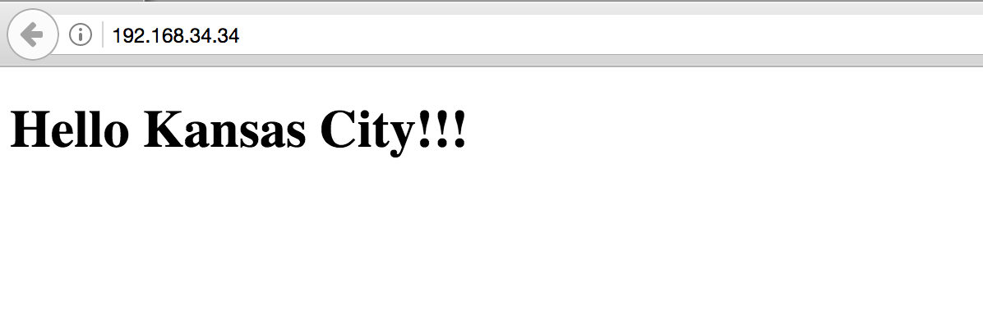
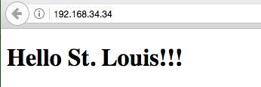


Webpage Local Network
chef exec kitchen converge
open http://192.168.34.34
chef exec kitchen destroy

Slide 27

Docker
Notes:
And my favorite (until I run into issues). Docker… or do we call this Moby now? I am confused by the current naming.
I want to note the way we are about to use Docker is not the standard way to use Docker. We are going to use it as a mini-vm. There are benefits here that it is faster than doing this with a VM. However this is likely not going to match what you have in production.

Slide 28
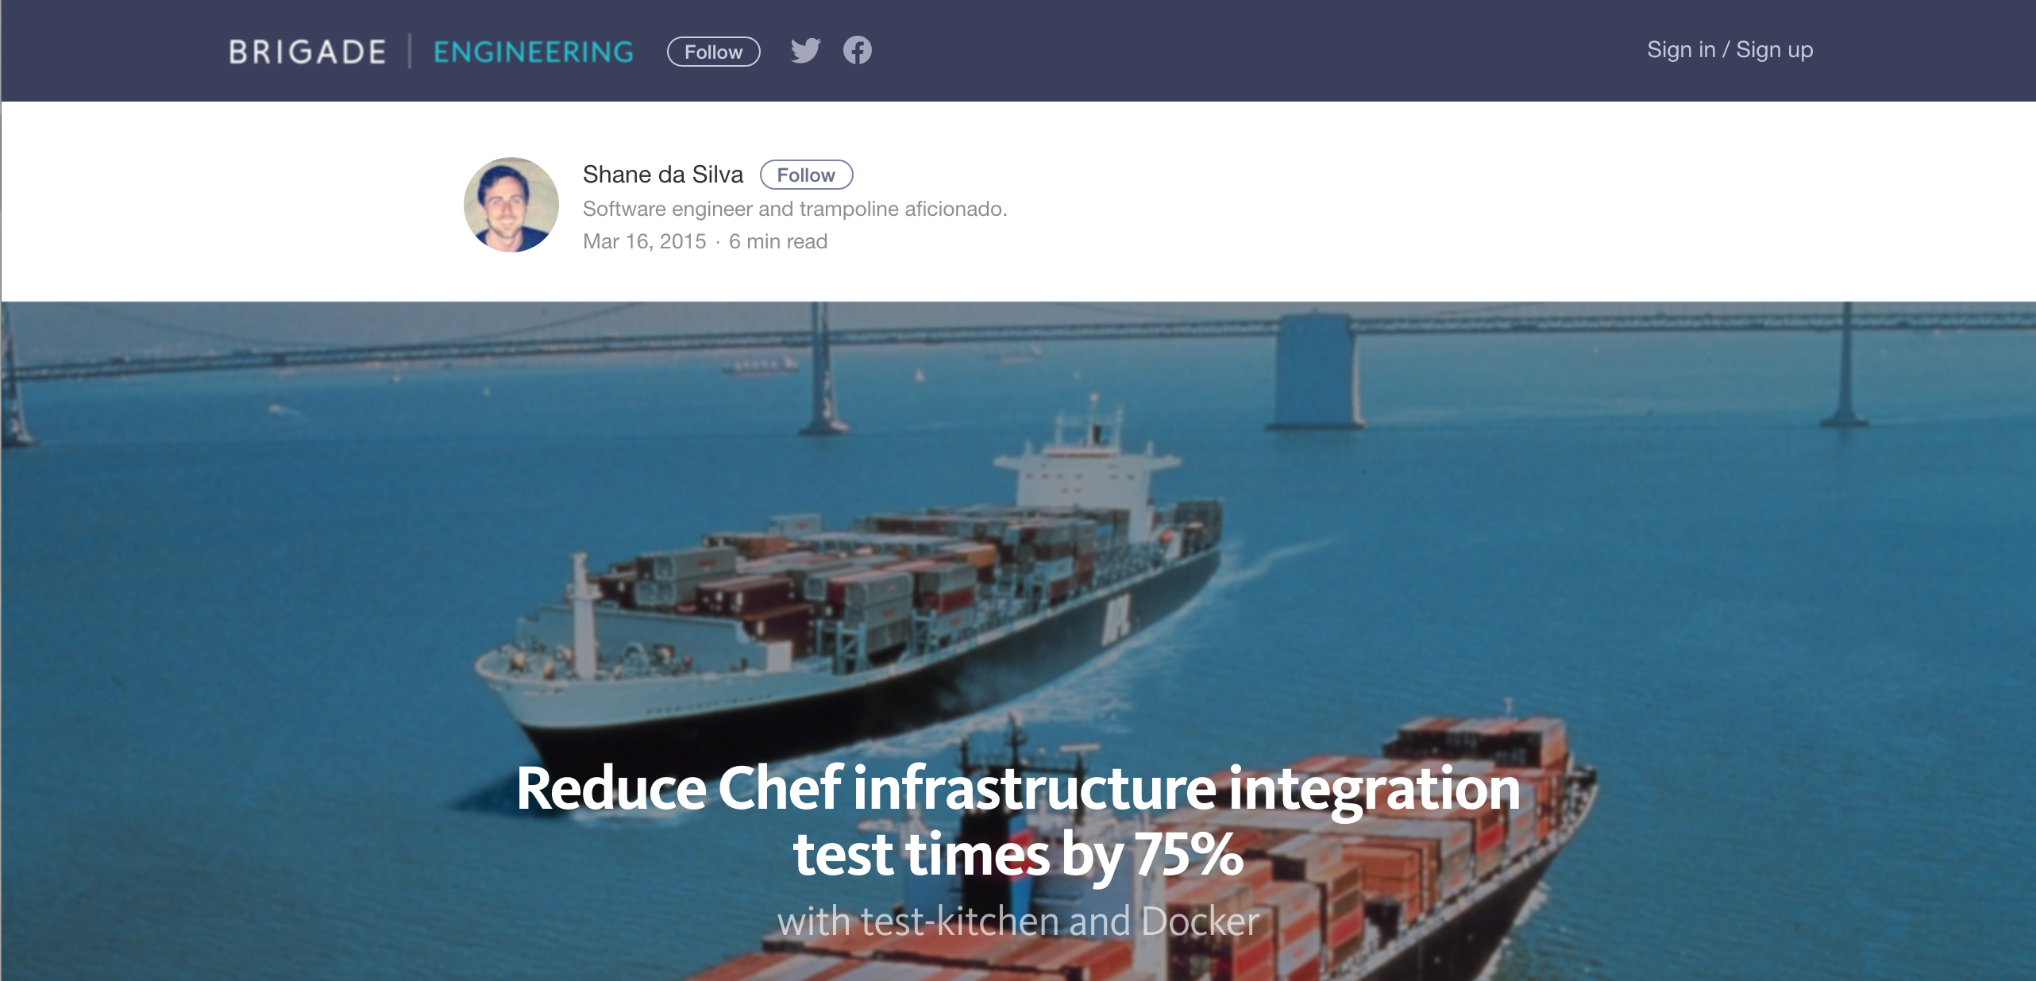
https://brigade.engineering/reduce-chef-infrastructure-integration-test-times-by-75-with-test-kitchen-and-docker-bf638ab95a0a
Notes:
However Brigade Engineering made a fairly strong case for using docker this way in March 2015 (2 years ago) when they showed they could get their matrix of tests from 2 hours to roughly 30 minutes.
I guess if this is wrong I don’t want to be right. I know that when I attach a debugger in development I am making things different than production, but I am doing so to iterate more quickly.

Slide 29


.kitchen.docker.yml
---
driver:
name: docker
forward: 80
use_sudo: false
provisioner:
name: chef_solo
verifier:
name: inspec
platforms:
- name: ubuntu-16.04
suites:
- name: default
run_list:
- recipe[hello_webpage_chef::default]
attributes:
Notes:
So I will define another kitchen file.
Here I am going to change the driver to docker.
Then I am going to forward the port 80 so I can access the resulting webpage.
I am going to set use_sudo to false, honestly because it works. This is a setting that I have played with.

Slide 30

Kitchen Docker
chef gem install kitchen-docker
export KITCHEN_YAML=.kitchen.docker.yml
chef exec kitchen converge
Notes:
If you don’t already have kitchen-docker you will need to install it on the chef embedded ruby.
Then we switch over to the kitchen docker file, and run kitchen converge.

Slide 31



docker ps -a
docker ps -a
CONTAINER ID IMAGE COMMAND CREATED STATUS PORTS NAMES
300d78a9450b 7d6f475b3253 "/usr/sbin/sshd -D..." About a minute ago Up About a minute 0.0.0.0:32770->22/tcp, 0.0.0.0:32769->80/tcp defaultubuntu1604-ablythe-AaronsMBP2-owxo2zer
open 0.0.0.0:<ip from docker ps>
chef exec kitchen destroy
Notes:
We should see the docker container show up when we run docker ps -a
Assuming we do then we can see that the port 80 is tied to a specific port and we can open that using the cool networking that docker provides.

Slide 32
AWS EC2
Notes:
So that is all well and good running local VirtualBoxes and Docker containers that quickly spin up solves the problem of allowing us to build machines using that fast feedback loop that we use to develop other software using an editor and command line.
However each problem solved presents a new problem. Now we are finding that while we have a more repeatable installation and configuration issues have gone way down, but the remaining ones are due to there being a difference in production. Say you are deploying to AWS solution to that is fairly simple. Starting running your tests on the AMI you are using in production.

Slide 33

Environment Variables
#!/usr/bin/env bash
export KITCHEN_YAML=".kitchen.cloud.yml"
export AWS_ACCESS_KEY="<key>"
export AWS_SECRET_KEY="<secret>"
export AWS_SSH_KEY_ID="<key_id>"
export AWS_SSH_KEY_FULL_PATH=“/Users/<yourname>/.ssh/<yourkey>.pem"
export AWS_SECURITY_GROUP_ID="<security_group_id>"
export AWS_SUBNET_ID="<subnet_id>"
Notes:
Many of the settings are sensitive or specific to your environment so you likely do not want to check them into your source control. Instead you can set environment variables that can be read by the kitchen.yml file.
I already have all of these set in my profile so I don’t end up sharing them with you.

Slide 34



.kitchen.cloud.yml
---
driver:
name: ec2
aws_ssh_key_id: <%= ENV['AWS_SSH_KEY_ID'] %>
security_group_ids: <%= ENV['AWS_SECURITY_GROUP_ID'] %>
subnet_id: <%= ENV['AWS_SUBNET_ID'] %>
region: eu-west-1
transport:
ssh_key: <%= ENV['AWS_SSH_KEY_FULL_PATH'] %>
username: ubuntu
provisioner:
name: chef_solo
verifier:
name: inspec
platforms:
- name: ubuntu-16.04
driver:
image_id: ami-405f7226
Notes:
Here I have switched over the driver to ec2.
I also set all of those environment variables as settings to be read in. I use Ireland for testing because it makes me think of green fields. We use a different region for production to have separation.
Also not that I am setting the AMI or Amazon Machine Image.

Slide 35

Kitchen AWS EC2
chef gem install kitchen-ec2
export KITCHEN_YAML=.kitchen.cloud.yml
chef exec kitchen converge
Notes:
If you don’t have the kitchen plugin for EC2 installed yet you will need that.
Then we will switch over to the .kitchen.cloud.yml
And run kitchen converge.

Slide 36

Notes:
Listen we have not known each other long. In the short time that we have I have created and destroyed many machines and containers. But I want to tell you this story about this place I worked. There were machines that had been around for a decade at they were named after the Rat Pack. You know Frank, Dean, Sammy the whole crew. They were hand built by many different engineers over the course of many years.

Slide 37

Notes:
Over time you develop a relationship with “Frank”. He really has a personality. You have good times, bad times and some whisky.

Slide 38

Notes:
In a situation like this no one wants to be the one that kills Frank.
http://www.imdb.com/title/tt0582157/?ref_=adv_li_tt

Slide 39


Slide 40

Kitchen EC2
chef exec kitchen login
open http://<ip from converge output>
chef exec kitchen destroy
Notes:
I want to destroy that image I just created because it is costing money

Slide 41
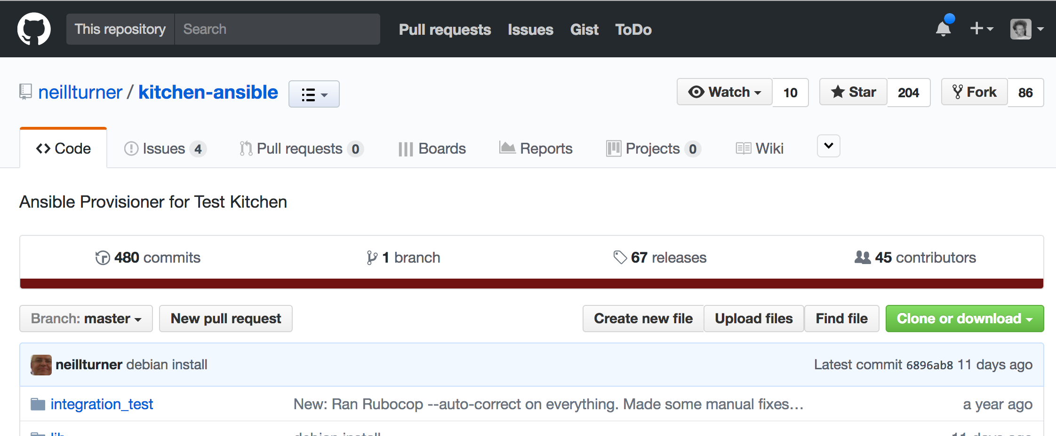
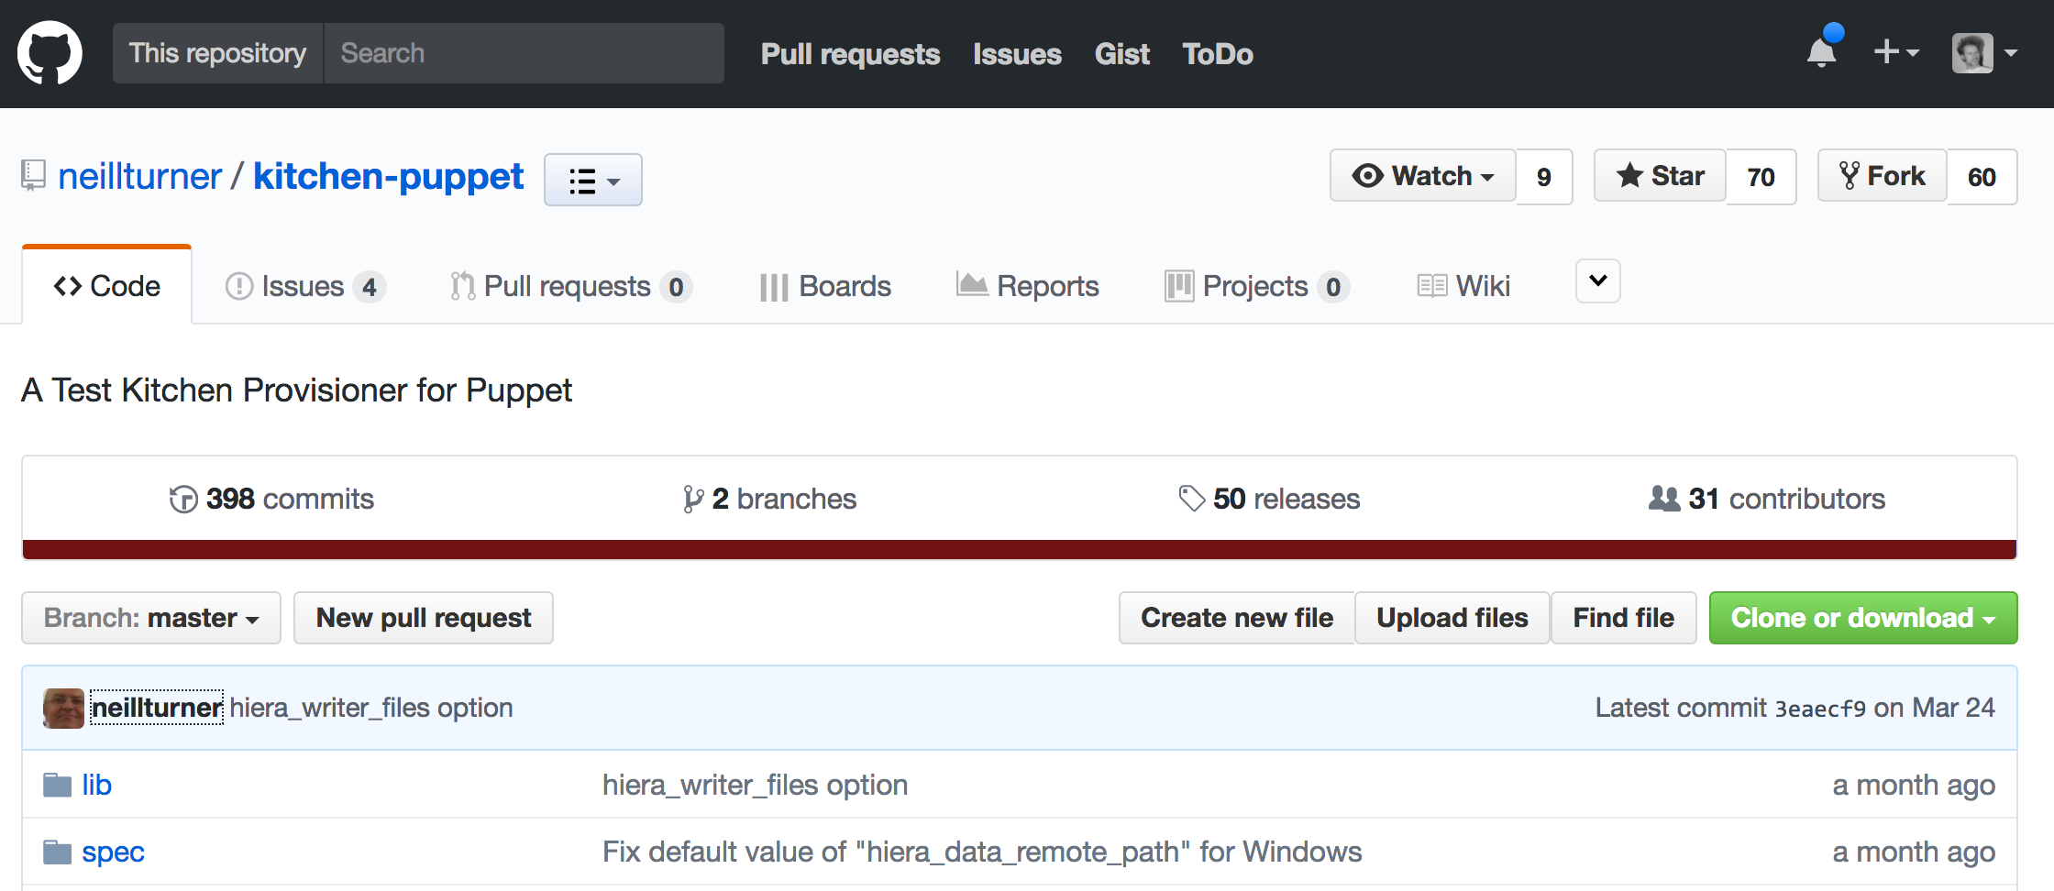
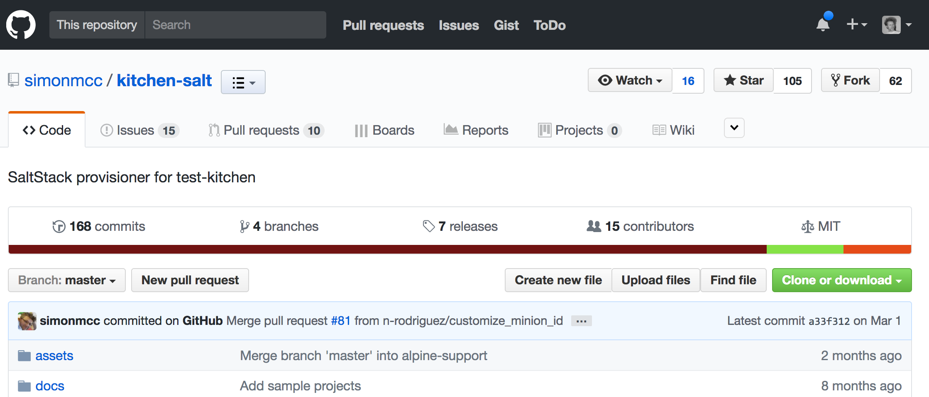
Many Configuration Management Tools

Slide 42






Many Configuration Management Tools
Ansible
Puppet
Salt
chef gem install kitchen-ansible
chef gem install librarian-puppet
chef gem install kitchen-puppet
chef gem install kitchen-salt
provisioner:
name: ansible_playbook
roles_path: roles
hosts: tomcat-servers
require_ansible_repo: true
ansible_verbose: true
ansible_version: latest
require_chef_for_busser: false
additional_ssh_private_keys:
- /mykey/id_rsa
provisioner:
name: puppet_apply
manifests_path: /repository/puppet_repo/manifests
modules_path: /repository/puppet_repo/modules-mycompany
hiera_data_path: /repository/puppet_repo/hieradata
provisioner:
name: salt_solo
formula: beaver
state_top:
base:
'*':
- beaver
- beaver.ppa
Notes:
Puppet Manifests, Ansible Playbooks, Salt (is it state files?) The salt provisioner likely needs some more work if you are interested in contributing. However the kitchen and ansible provisioners from neilturner seem to remain fairly active.

Slide 43


Kitchen Terraform
https://github.com/newcontext-oss/kitchen-terraform/
https://youtu.be/1Kj3I4PZXdE
Notes:
So spinning up a machine is great, but what if you could spin up your entire infrastructure this way. Meaning your security groups, your networking all the fun bits.
There is also a very active project that I have been watching from New Context that allows you to bring up a terraform stack in the context of test kitchen. It has been maintained well by Aaron Lane and there is a great talk from DevOpsDays Chicago last year where Nell Shamrell-Harrington explains how she used it to help refactor her infrastructure.

Slide 44
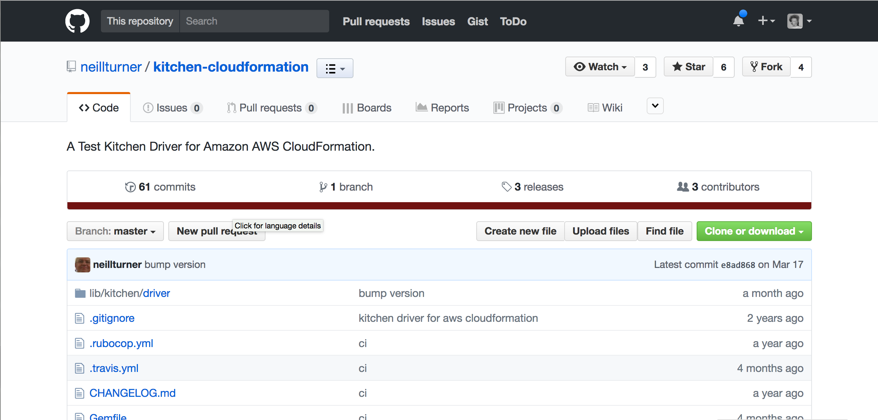
Kitchen Cloudformation
Notes:
If you haven’t made the jump to Terraform and are still doing CloudFormation Templates, again we turn to Neil Turner. This project is not as popular as his Ansible or Puppet projects. Likely because Cloud Formation is a great spec but hard to work with as a human and needs a wrapper like Terraform. I will note that it has gotten better in the last year with the addition of support for yaml.

Slide 45
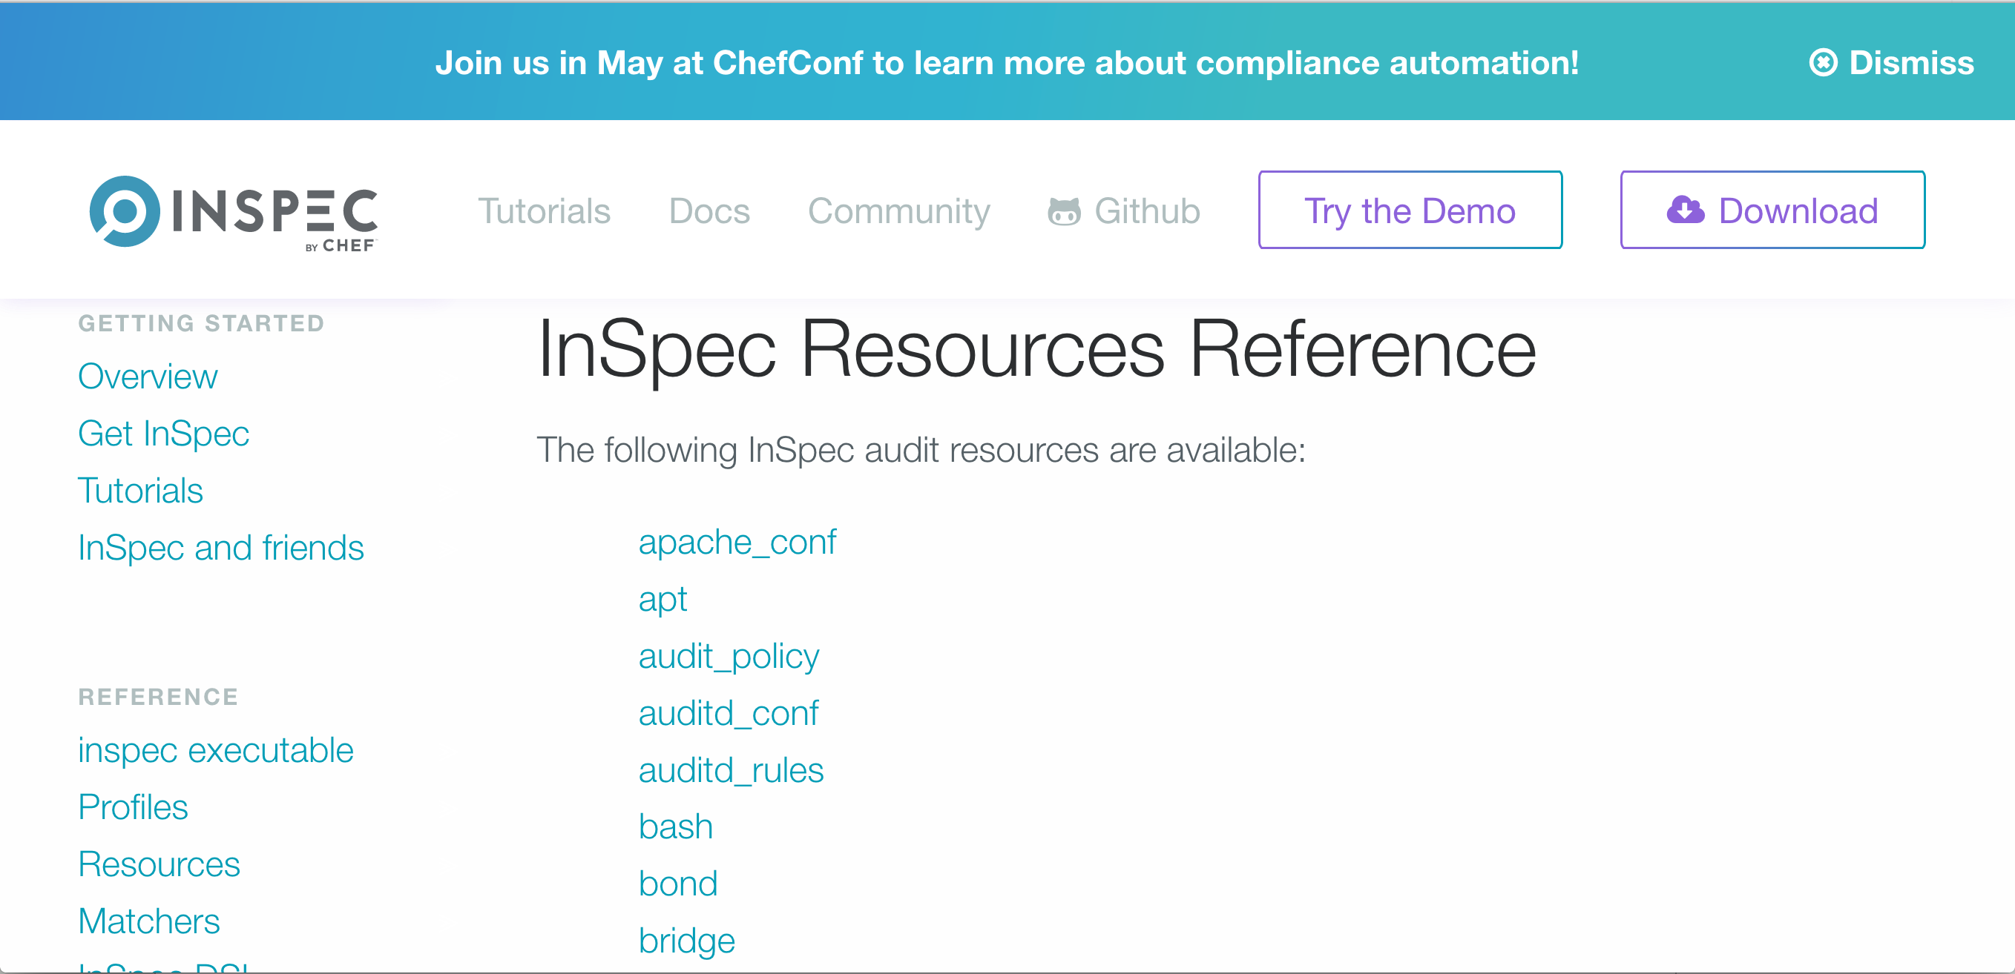
InSpec
http://inspec.io/docs/reference/resources/
Notes:
Inspec provides us behavior driven development for our machines and infrastructure.
So if you are used to rspec, cucumber, jbehave, easyb or other BDD frameworks, then you like know what I mean. If you are not then that is no worries we are about to go over it.
The resources are awesome and fairly comprehensive for the things that you regularly do when configuring a machine for use.

Slide 46

export KITCHEN_YAML=.kitchen.docker.yml
chef exec kitchen verify
Notes:
I am going to go back to verify against our docker container because it was the fastest.

Slide 47
Trinity
of Config Management
Install Package
Manage Service
Config Files
Notes:
If you have taken a class on Chef or Puppet then maybe you have heard of the Trinity of Config Management.
I don’t say Holy Trinity, I say Trinity…

Slide 48

Trinity
Notes:
Cause Trinity is freaking awesome
I could watch that all day.

Slide 49

Trinity
Notes:
Here is me doing the whole Matrix thing. My hair was shorter then…

Slide 50

Installed Package
describe package('apache2') do
it { should be_installed }
end
describe command('apache2 -v') do
its(:exit_status) { should eq 0 }
its(:stdout) { should match(%r{/Server version: Apache\/2.4/}) }
end
Notes:
I love rspec because of how readable it is in general. With Inspec we now have these resources that make this even easier. So instead of running some command like

Slide 51

Service
describe upstart_service('apache2') do
it { should be_installed }
it { should be_running }
end
Notes:
Here I am describing the service that should be installed and running.

Slide 52

Manage Config Files
describe apache_conf do
its('Listen') { should eq ['*:80'] }
its('AllowOverride') { should contain 'None' }
end
describe file('/var/www/html/index.html') do
it { should exist }
it { should be_file }
it { should be_owned_by 'root' }
its(:content) { should match(/Kansas City/) }
end
Notes:
There are resources for some common specific things such as the apache configuration file.
However more often than not I use the simple file resource to test specific things about a configuration file.

Slide 53

Per OS Specific Specs
if os[:family] == 'debian'
describe upstart_service('apache2') do
it { should be_installed }
it { should be_running }
end
elsif os[:family] == 'redhat'
describe service('httpd') do
it { should be_installed }
it { should be_running }
end
end
Notes:
Some times the tests will be slightly different for one OS to the next. As you may know the apache package is called ‘apache2’ on debian systems, it is called ‘httpd’ on Redhat like systems. Inspec allows you to simply
So for ruby/rails development I have been trying to follow http://betterspecs.org/ which states that you should use the expect syntax over the should syntax. However they did a survey at Chef Compliance and most people were still using the should syntax so they have stuck with this for the examples.

Slide 54
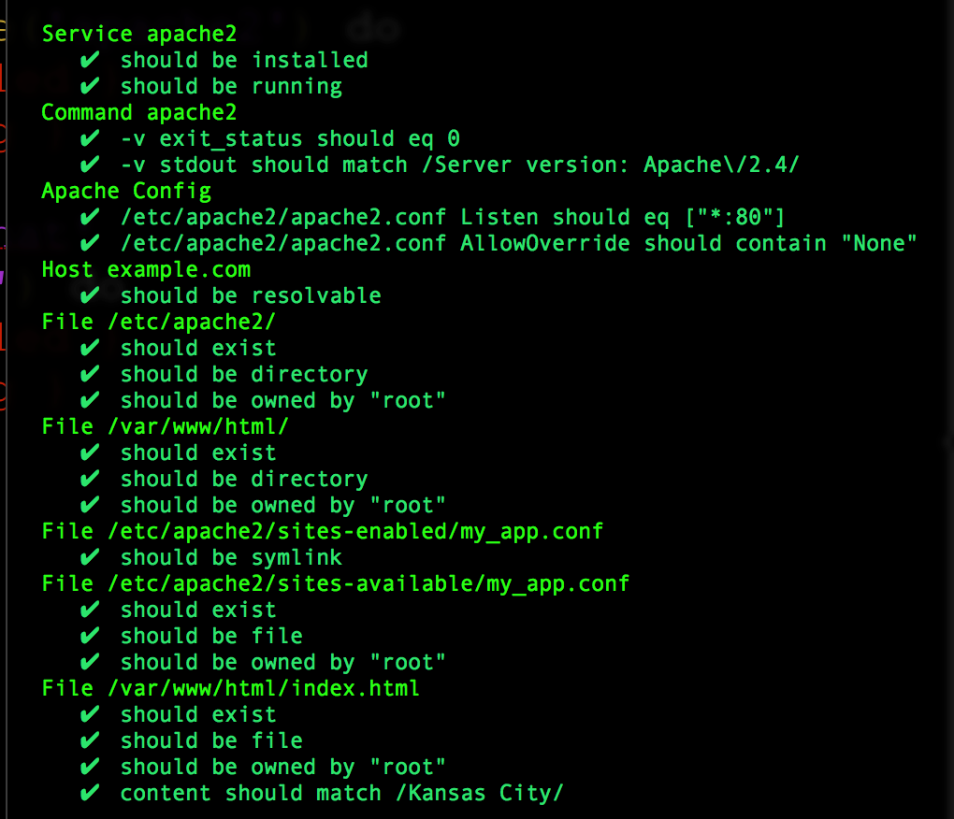
Notes:
Part of the reason they site for sticking with it is the blocking of the output like this. Which I have to admit looks pretty darn slick. You don’t have to be the deep expert on the entire stack to see where the issue is. Once you put this into your continuous integration or continuous deployment system, now anyone on the team can see the issue in plain english.

Slide 55
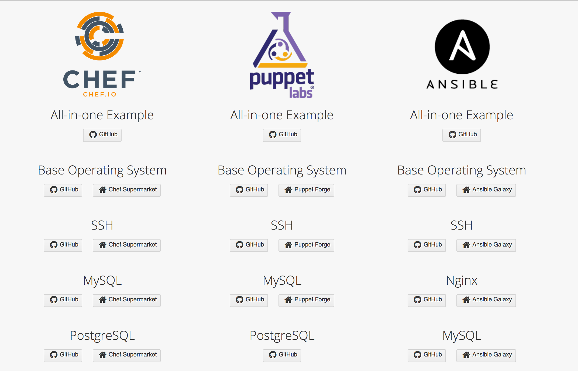
http://dev-sec.io
Notes:
Whether or not you have checked out dev-sec.io I highly recommend it. It was created by a company originally called VulcanoSec by Dominick Richter and Christoph Hartman in Germany. It became part of the Chef family last year and many of their ideas are being integrated into the Chef Enterprise Tool called Compliance. However there is a lot to dig into on the open source side.

Slide 56
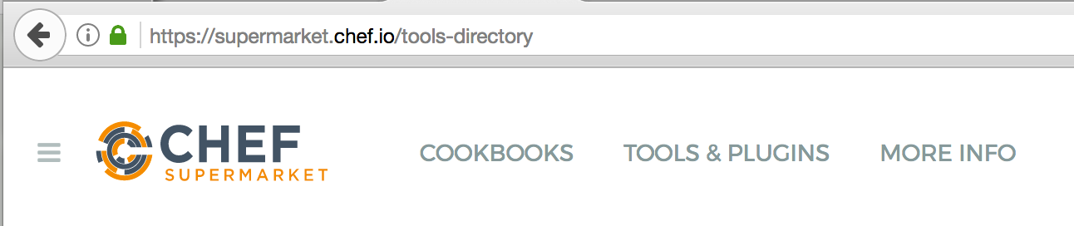

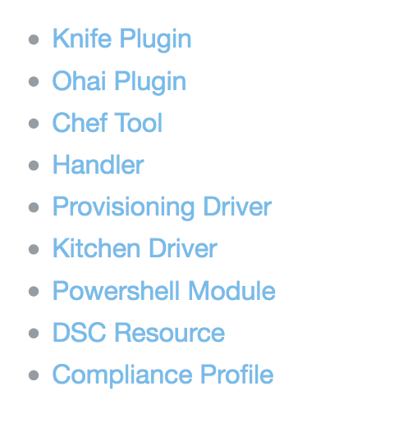


Slide 57
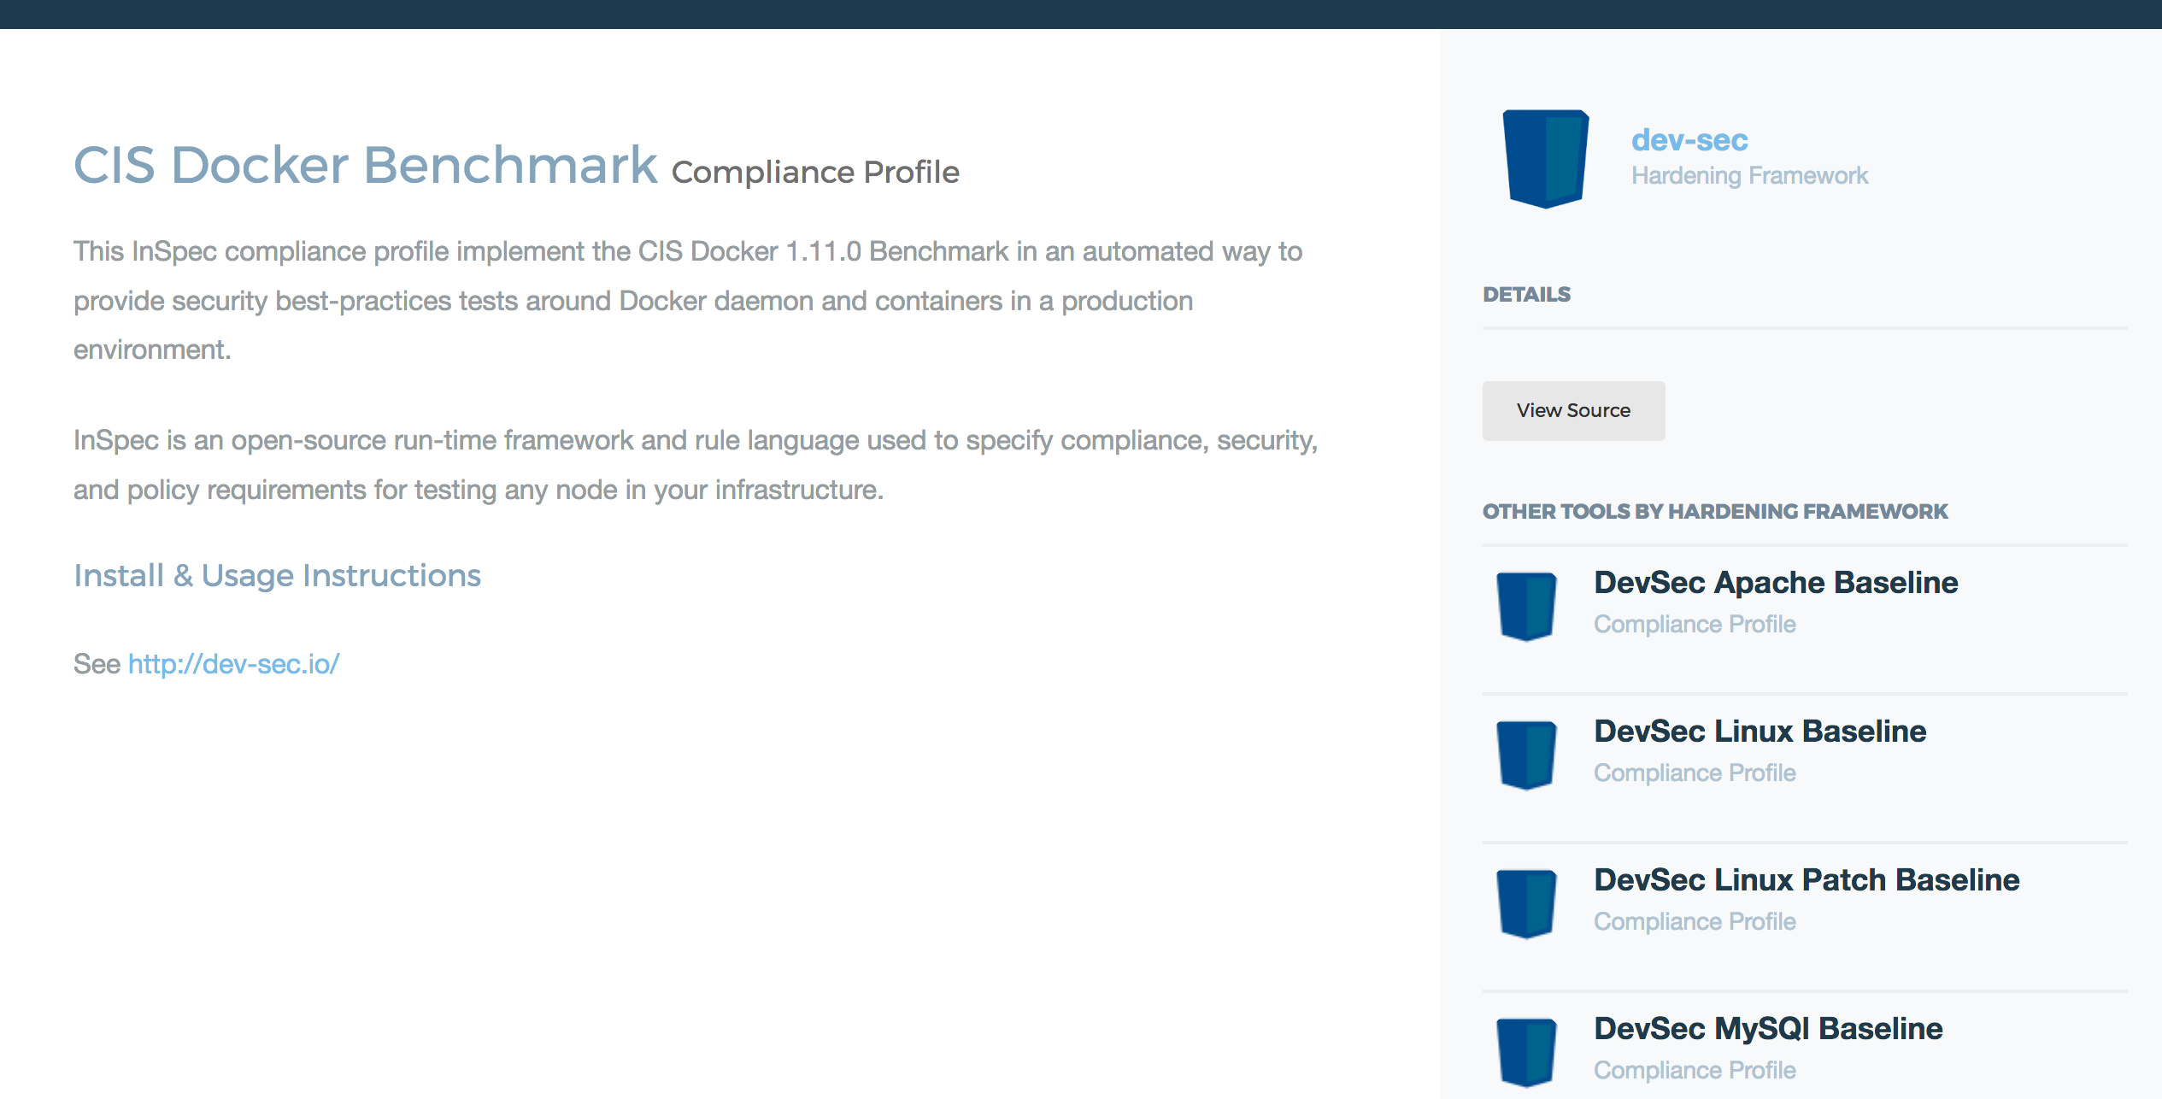

Supermarket
Notes:
There are some ready maid open source profiles from some wicked smart security dudes that you can apply to your image in seconds.

Slide 58


---
driver:
name: docker
forward: 80
use_sudo: false
provisioner:
name: chef_solo
verifier:
name: inspec
sudo: true
platforms:
- name: ubuntu-16.04
suites:
- name: default
run_list:
- recipe[hello_webpage_chef]
verifier:
inspec_tests:
- supermarket://dev-sec/linux-baseline
attributes:
Notes:
So this part is not necessarily clear in the documentation and the way that the supermarket URLs are laid out. But you have to take the user then the name of the profile and add that in.
Certainly you can check the docs and you can add a local file, a github url, etc. and pull these profiles from there.

Slide 59

export KITCHEN_YAML=.kitchen.audit.yml
chef exec kitchen verify

Slide 60
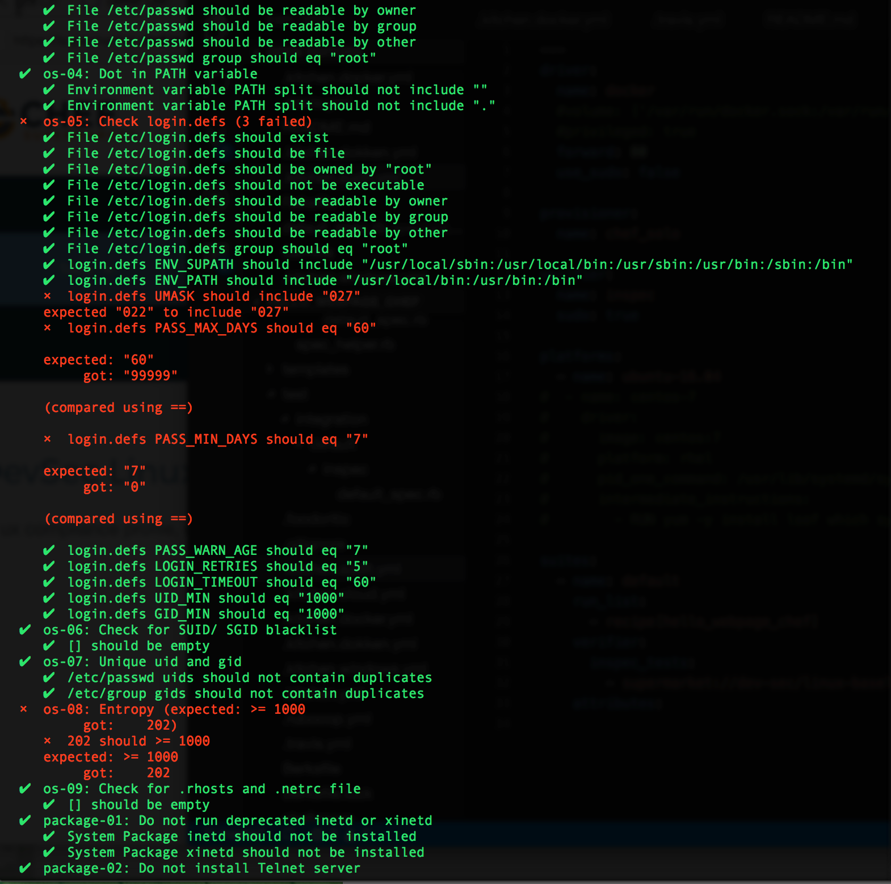
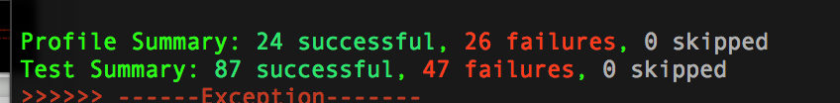
Notes:
Here I applied the linux-baseline on a docker container so I would get some failures. This runs in less than a minute.

Slide 61
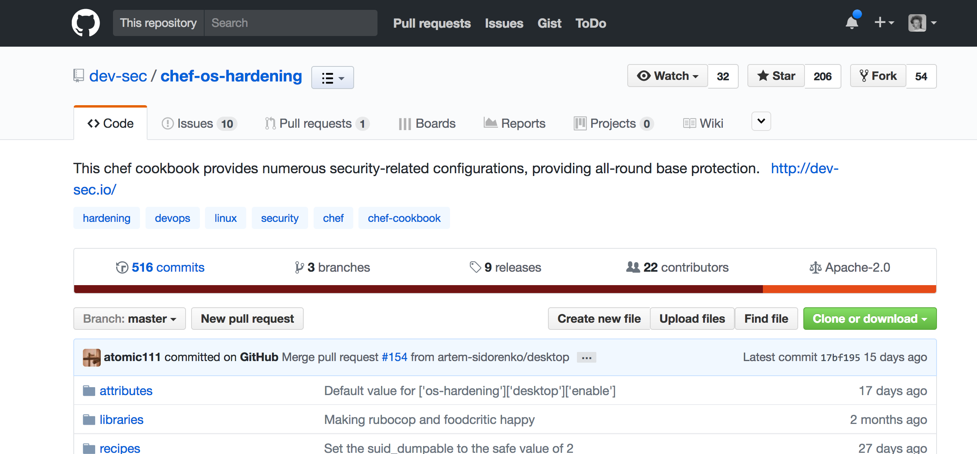
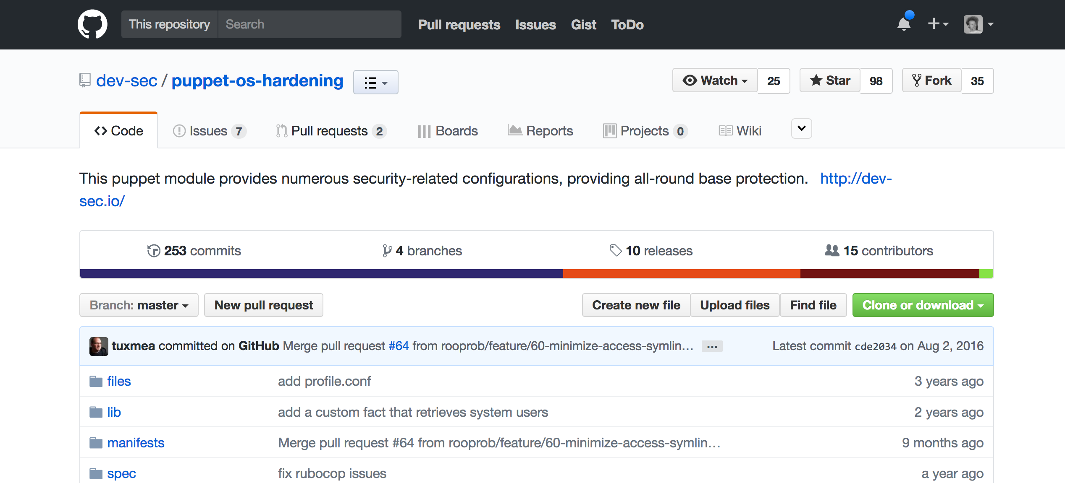
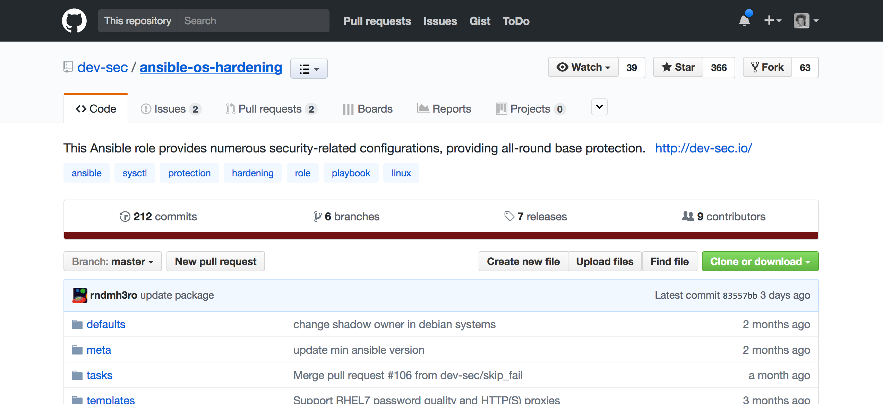
Notes:
Great part about dev-sec.io is that there is a corresponding Chef cookbook, Puppet module and Ansible role to be bring you up to compliance. Don’t agree with all of the tests or configurations, that’s cool it is open source, you can fork it and take the one’s you do agree with.
Most of the recommendations come from

Slide 62
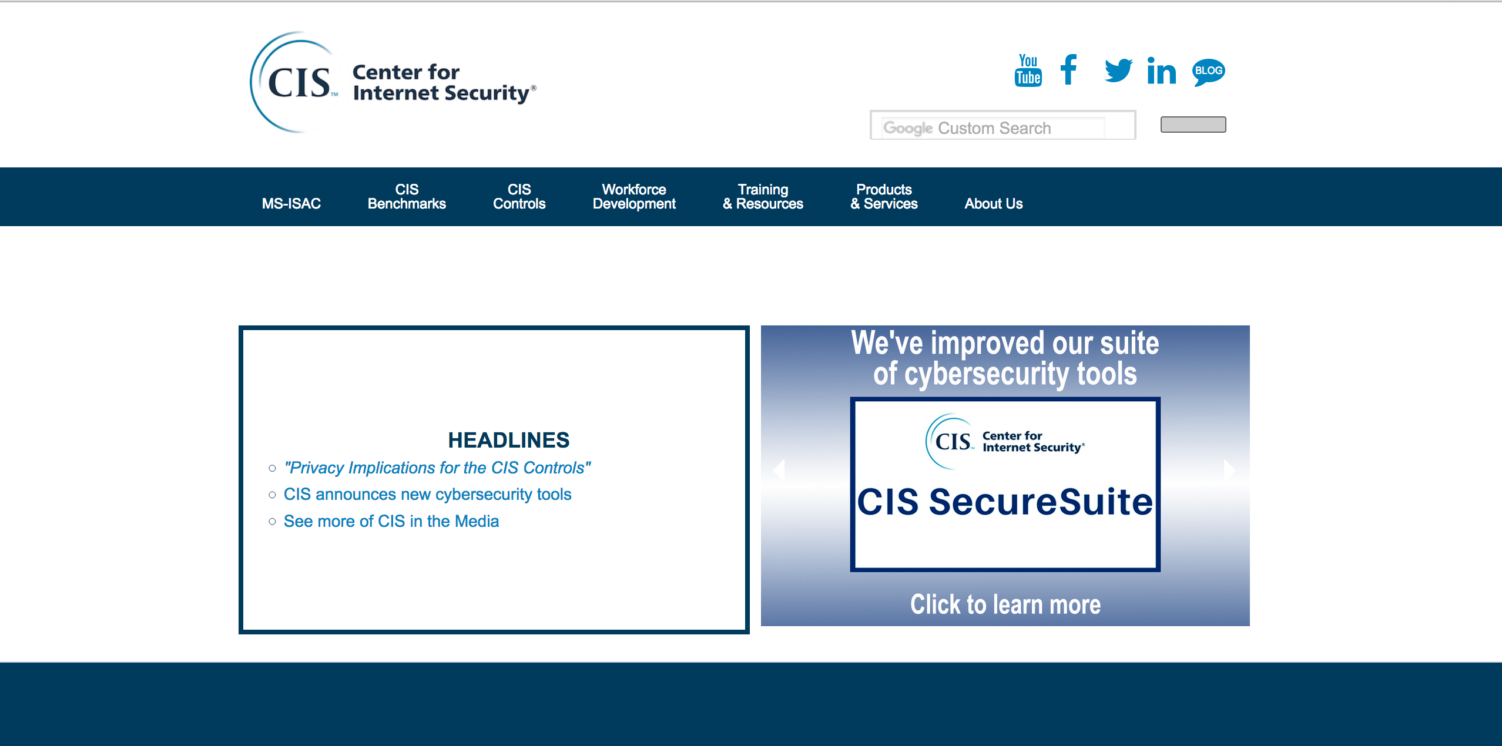
https://www.cisecurity.org/
Notes:
Most of the rules come from the CIS so this is a great way to show compliance.

Slide 63



Actual Docker Testing
---
driver:
name: docker
forward: 80
use_sudo: false
provisioner:
name: shell
verifier:
name: inspec
sudo: true
platforms:
- name: ubuntu-16.04
driver_config:
image: ubuntu:16.04
platform: ubuntu
suites:
- name: default
verifier:
inspec_tests:
- supermarket://dev-sec/cis-docker-benchmark
attributes:
Notes:
For those of you who are like. I am devops enlightened. I no longer use VM’s only docker, and I do not run Configuration Management inside of docker, I use Packer to run Configuration Management to create my docker images then I run those on Kubernetes… Cool… you can still use this methodology and likely have security concerns you want to check in your CI/CD process.
Simply use a provisioner of shell and define the image you would like
Our buddies at dev-sec.io even have a CIS docker-benchmark they are working on.

Slide 64

# need version of inspec above 1.21.0
chef gem uninstall inspec
chef gem install inspec
export KITCHEN_YAML=.kitchen.docker.audit.yml
chef exec kitchen converge
Notes:
Note that this is so new (Inspect 1.21.0 came out last week) that you might have to hack in the version, which will break the inspec binary.

Slide 65
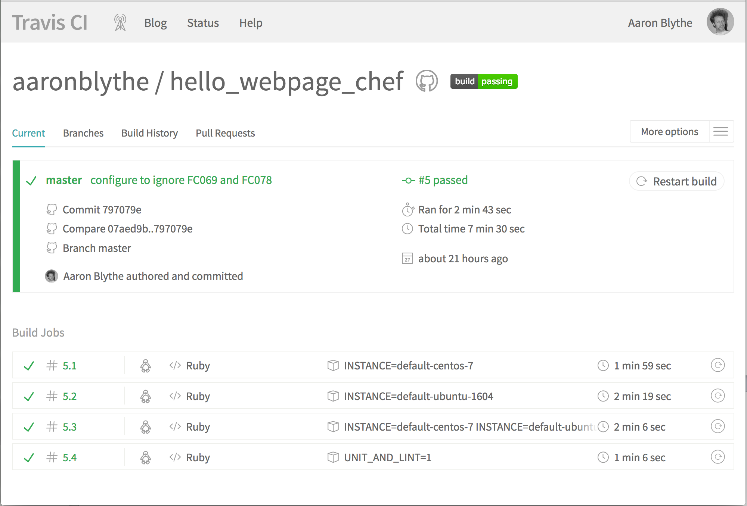

Continuous Integration - travis-ci
https://travis-ci.org/aaronblythe/hello_webpage_chef
Notes:
The example project that I have been using all day is actually built in travis.ci.
I have done this in Jenkins in the past using vagrant and docker drivers. I have yet to setup the AWS driver, but I imagine this is simple enough.

Slide 66

.travis.yml
services: docker
env:
matrix:
- INSTANCE=default-centos-7
- INSTANCE=default-ubuntu-1604
before_script:
- sudo iptables -L DOCKER || ( echo "DOCKER iptables chain missing" ; sudo iptables -N DOCKER )
- eval "$(/opt/chefdk/bin/chef shell-init bash)"
script: KITCHEN_LOCAL_YAML=.kitchen.dokken.yml /opt/chefdk/embedded/bin/kitchen verify ${INSTANCE}
matrix:
include:
- before_script:
- eval "$(/opt/chefdk/bin/chef shell-init bash)"
- /opt/chefdk/embedded/bin/chef --version
- /opt/chefdk/embedded/bin/cookstyle --version
- /opt/chefdk/embedded/bin/foodcritic --version
- script:
- /opt/chefdk/bin/chef exec rake
env: UNIT_AND_LINT=1
https://blog.chef.io/2017/04/12/fresh-new-stuff/
Notes:
Kitchen dokken is a creation of Sean O’Meara at Chef. It is more chef specific than Kitchen Docker which I showed previously. Just a couple weeks ago Tim Smith a Community Chef Engineer did a video on the chef blog about how to set this up.

Slide 67
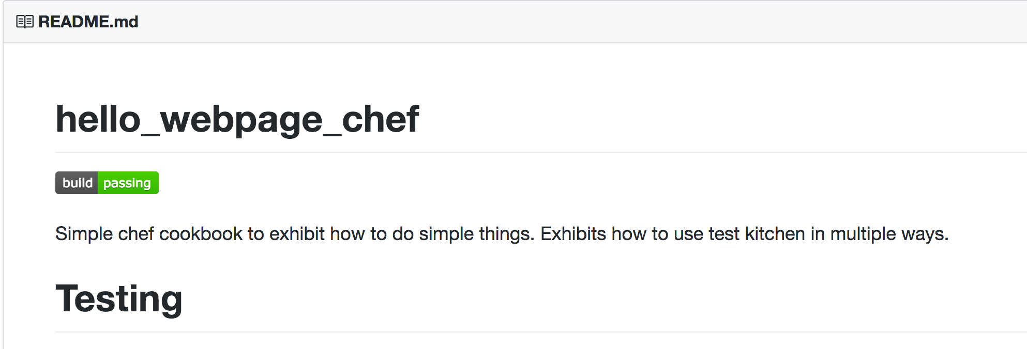
github.com README status
Notes:
To get to the Travis link simply click on the build button in github from the link I tweeted out.

Slide 68
Test Kitchen Steps
Define
.kitchen.yml
Create
Machine
Provision
Machine
Verify
Machine
Destroy
Machine
10 seconds
10 minutes
10 seconds
20 minutes
1 second
2 minutes
1 second
1 minute
10 mins
4 hours
22 seconds
34 minutes
Notes:
So in conclusion, I hope you see the benefit of this harness and it’s line of thinking. Testing this way has saved me a ton of time.
If you try out any of the things here and they don’t work feel free to log and issue to the repo that I tweeted out and we can work through it together.

Slide 69
References and Thanks
Fletcher Nichol and Chef - Test Kitchen https://github.com/test-kitchen/test-kitchen
Mitchell Hashimoto and Hashicorp - Vagrant, Packer, Terraform and others
Rob Reynolds - Chocolatey - https://chocolatey.org/
Matt Wrock - all the Windows stuff - http://www.hurryupandwait.io/
Shane da Silva - Brigade Engineering https://brigade.engineering/reduce-chef-infrastructure-integration-test-times-by-75-with-test-kitchen-and-docker-bf638ab95a0a
Sean Porter - Kitchen Docker https://github.com/portertech
Sean O’Meara - Kitchen Dokken https://github.com/someara/kitchen-dokken
Tim Smith - Community Cookbook Support https://blog.chef.io/2017/04/12/fresh-new-stuff/
Dominick and Christoph Hartman - Dev-Sec.io and great Inspec work http://dev-sec.io/
Noah Kantrowitz - CodeRanger - Answering tons of my questions over the years https://chefcommunity.slack.com/
Notes:
Consider this page to be like a credits page on a show or a movie. Open source is awesome because people like these people work hard and put awesome things out there. One person I did not mention in the course of the talk is Mitchell Hashimoto who was the creator of Vagrant that set pretty much all of this in motion. Since then many other great command line UX tools have come out of Hashicorp including Packer and Terraform that I mentioned.

Slide 70


announcements
How are we doing? Do survey for chance of winning Xbox One and other prizes.
Wireless
SSID: SilverLiningsAttendees
Password: Section31
http://bit.ly/StlSLSurvey
Notes:
Please do give the organizers feedback on the things you are seeing throughout the day. They are looking to learn and continuously improve. Your feedback is important to that improvement.

Slide 71
Testing should
match Production
be fast
be simple
be repeatable

Slide 72
Machines/containers should be built from scratch

